Slide 1

Turbo Jet 2: Design Review
Mitchell Matthews, Sergio De Leon, Ethan Bergman, Kyle Marshall, & Roshan Jaiswal-Ferri

Slide 2
Agenda:
Take Aways from Turbo Jet 1
Overview
Preliminary Design Calculations
Test Stand
Compressor
Inlet
Shaft
Ignition and fuel
Combustion chamber
Turbine
Stator and Nozzle
Instrumentation
General safety

Slide 3
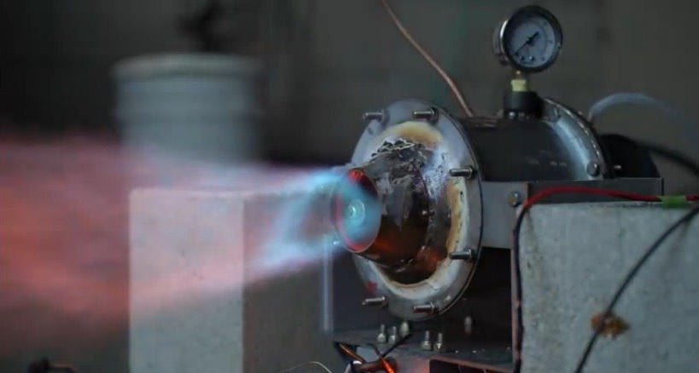
Turbo Jet 1 Take Away
Recap:
Designed and manufactured Turbo jet with a car turbo compressor and turbine
Conducted 3 testing sessions none gave satisfactory results
Lessons
Design for assembly
Grab as much data as possible from tests
Gap losses
Thermal expansion of turbine
Use easy to work materials
CAD communication

Slide 4
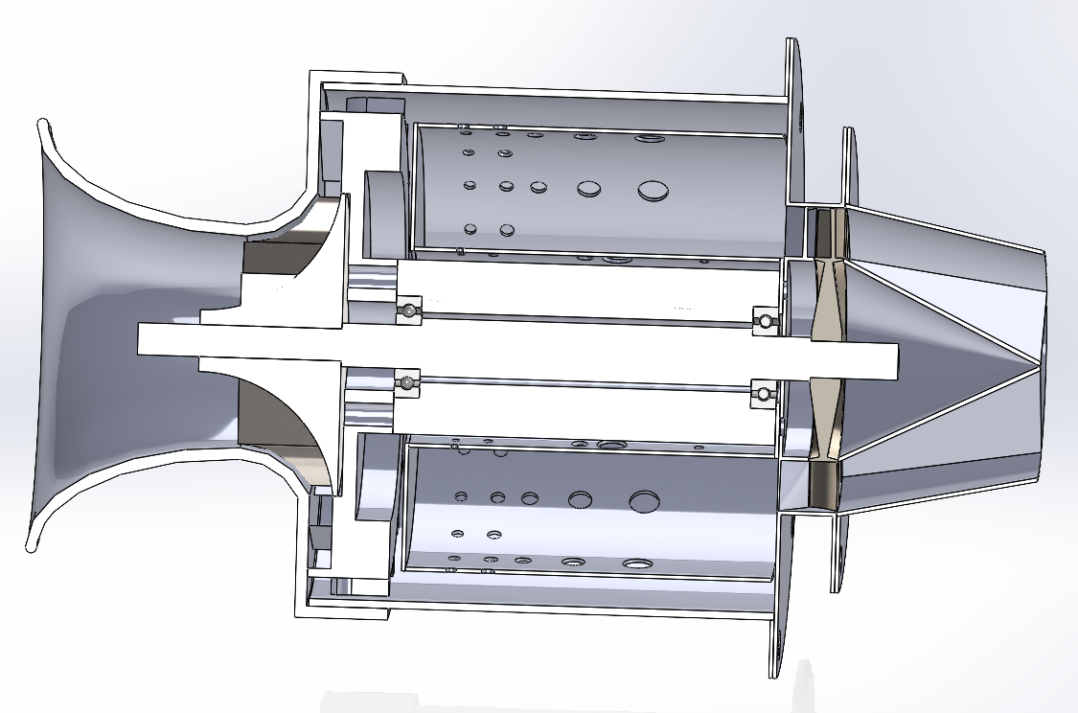
Overview
Goals:
Design, manufacture, and test a micro turbojet engine for under $600
Achieve idle RPM ~ 35k
Create a platform to experiment with other turbojet technologies and acquire data for optimization
Engine:
Outer Diameter 4.5”
Compressor Impeller and Turbine wheel from KJ 66 engine (66mm diameter)
Thrust around 5 lbs

Slide 5
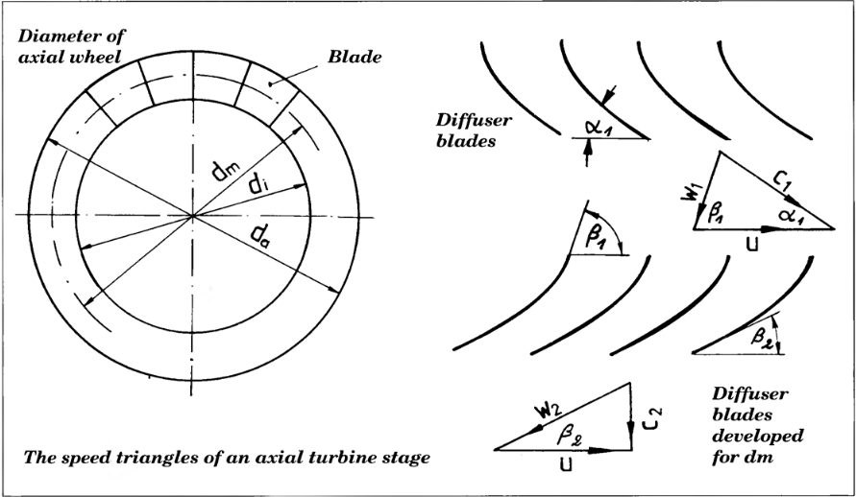
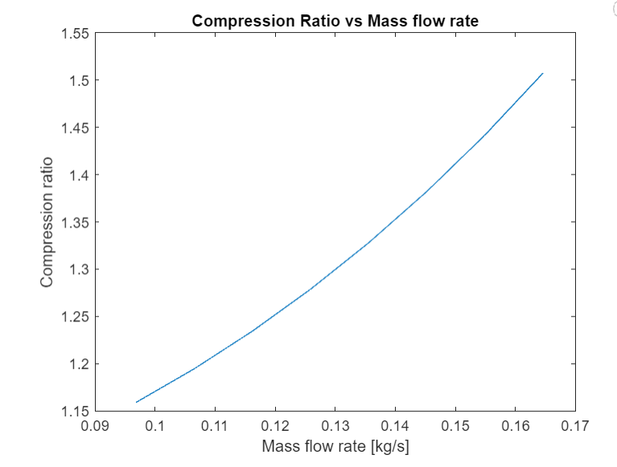
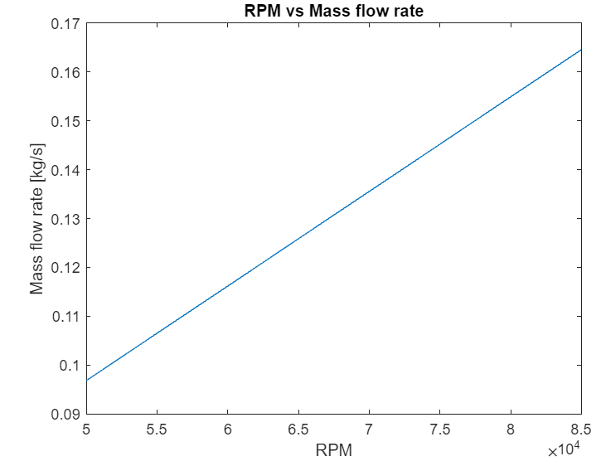
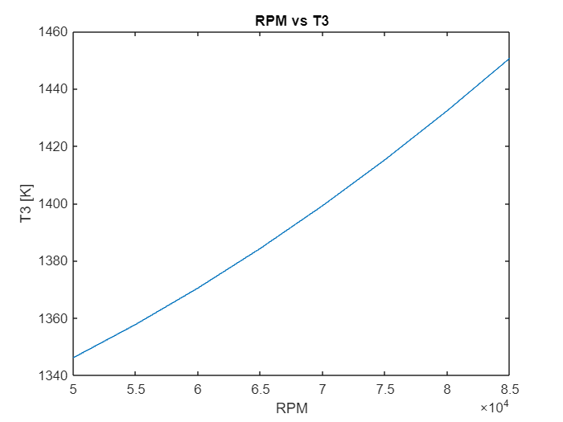
Preliminary Design Calculations:
Followed Design Equations from:
- Gas Turbine Engines for Model Aircraft, Kurt Schreckling​
Model Jet Engines, Thomas Kamps​
Calculations based on geometry and material of turbine

Slide 6
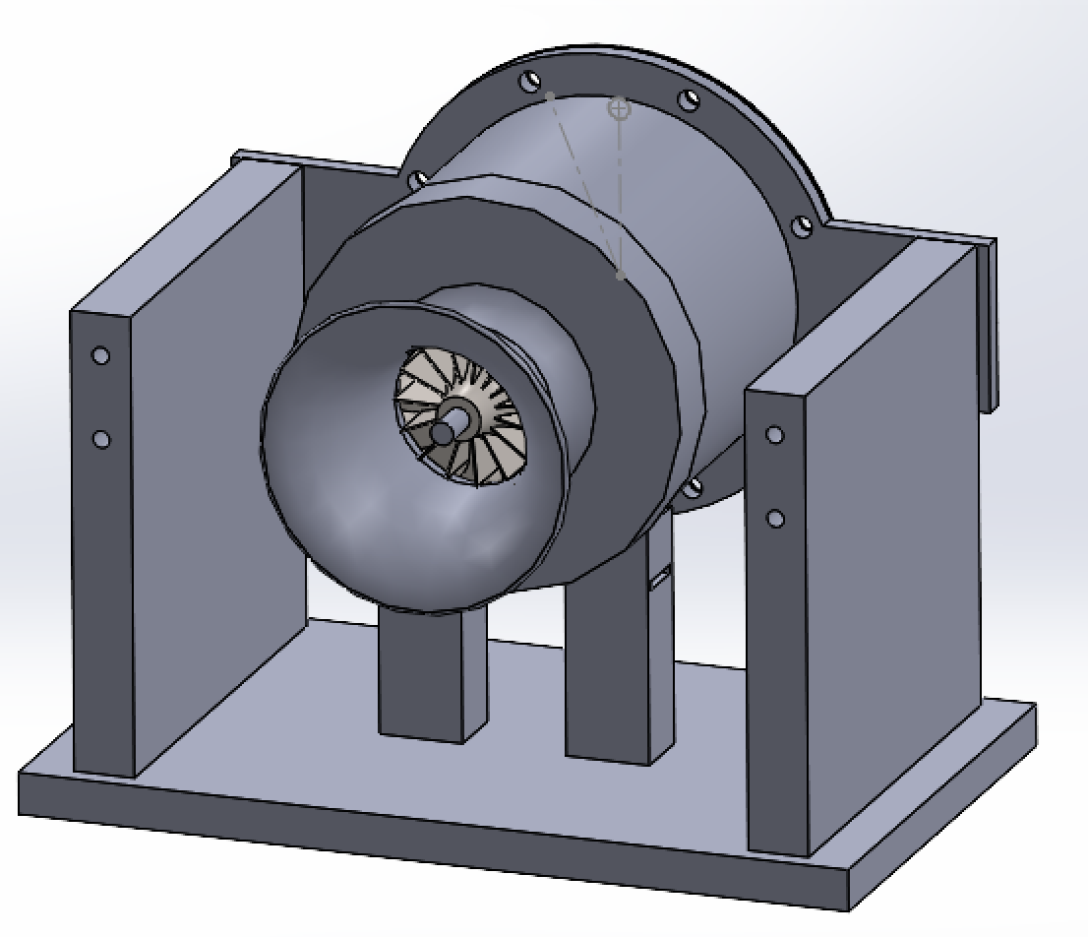
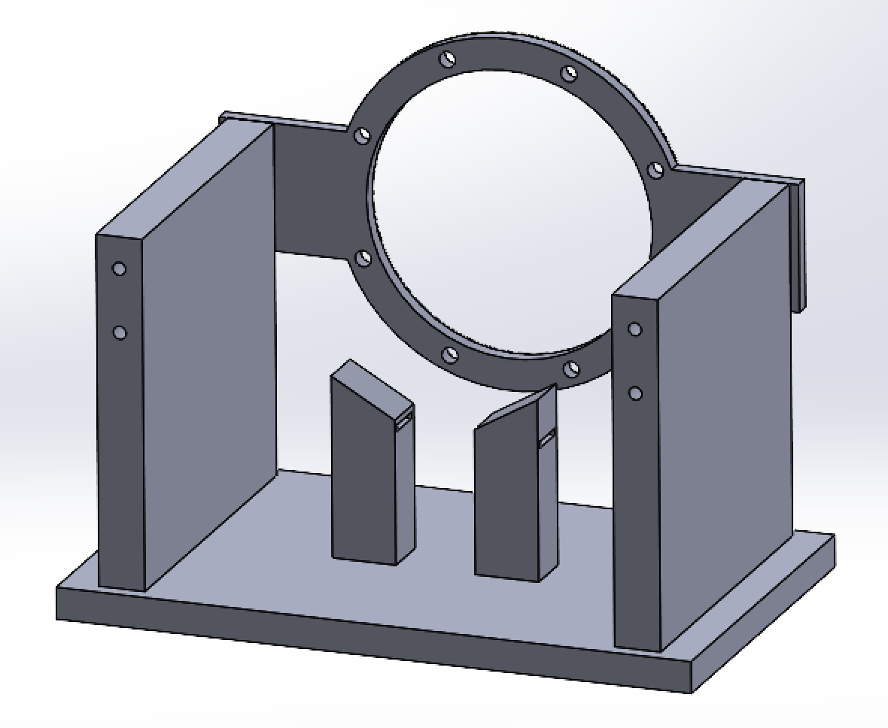
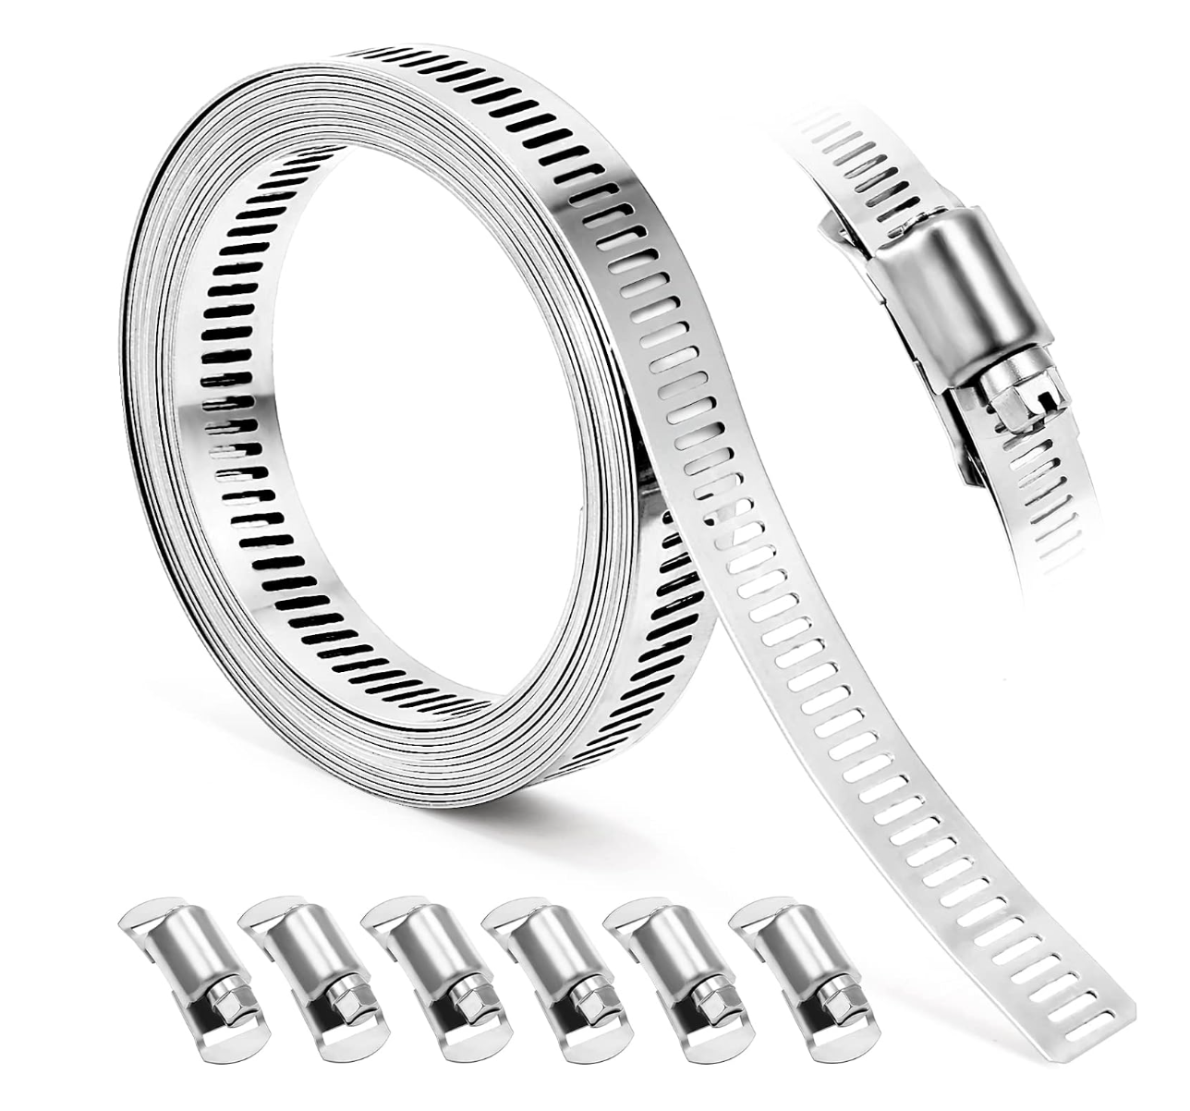
Test Stand
Utilizing old test stand parts to reduce manufacturing and reuse materials.
Remaking ring bracket to new diameter of engine.
The ring bracket and mounting walls will take most of the forces
Since no mounting flange on compressor side, using angled posts and hose clamp strap to wrap around engine and through posts.
The thrust is expected to be low, maximum 6lbs, so we aren't concerned about heavily locking it down.
The front strap holds engine in place and reduces vibrations.
Notes:
Kyle is presenting this.

Slide 7
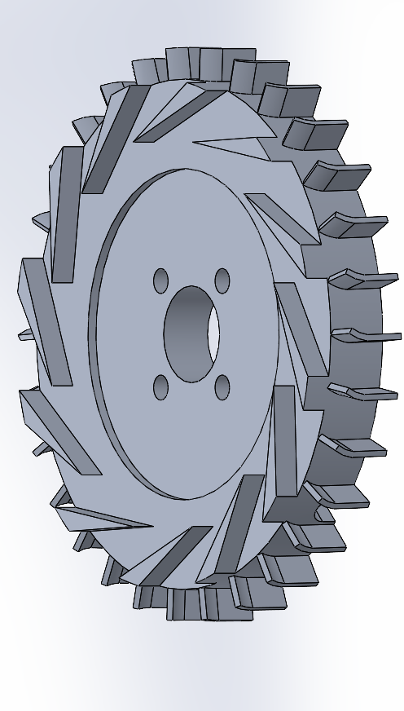
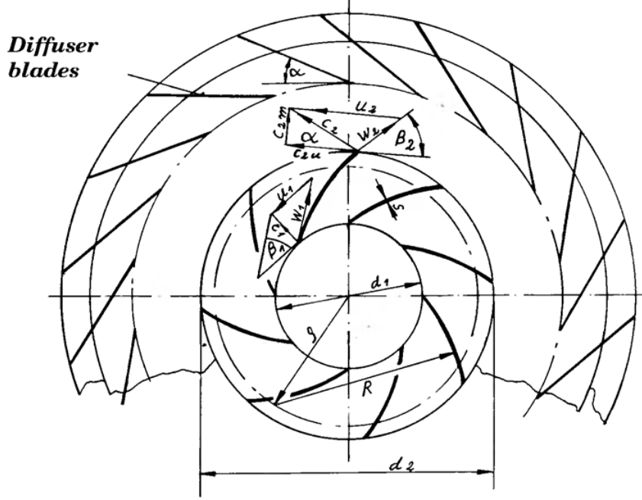
Compressor
Diffuser
Aluminum
Guide vanes based on impeller flow exit angle (about 17.5 degrees)
Looking into CNC but might be manually machined
Gap before wedges (1.2*impeller diameter)
Diffuser diameter (1.6*impeller diameter)
Impeller
KJ66 impeller
Design and manufacturing was too complex for manual machining and preliminary design
Gas Turbine Engines for Model Aircraft, Kurt Schreckling

Slide 8
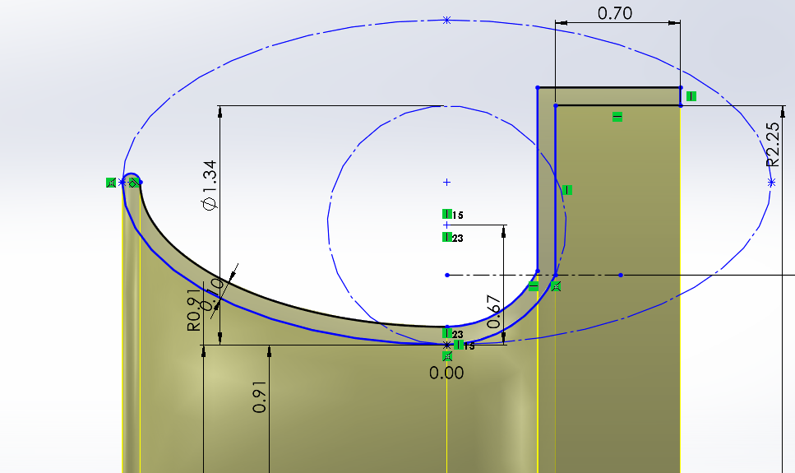
Inlet
Inlet design is based on a paper for ideal bell curve
Ellipse with double the inlet radius width
3D print out of PETG
Starting with compressed air

Slide 9
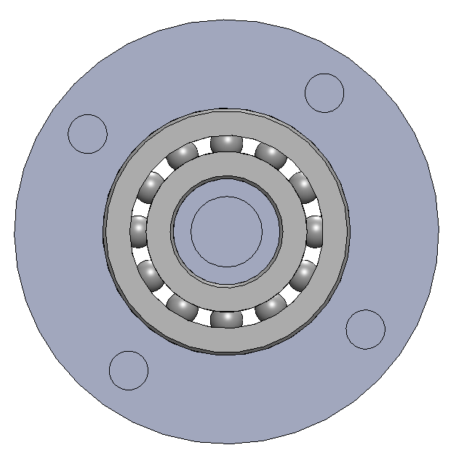
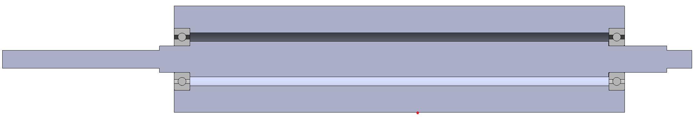
Shaft
Inner shaft will be machined on Four jaw chuck to ensure that perfect concentricity or at least low margins of error.
Outer Shaft machining will use 3/4 jaw chuck on lathe and the Mill for bolt hole patterns.
Cold rolled Carbon Steel for both objects:
Readily availably and cheap.

Slide 10

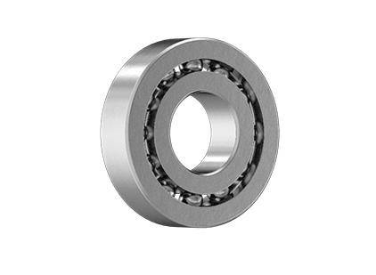
Extra Info:
R6 Bearing:
Bearing Dynamic Load: 590 lbs. for radial loading and theoretical thrust load 590 lbs. * 20% = 118 lbs.
Readily availably, fits out standards/goals, and high melting point.
Must inspect for damages and must do a cleaning process. (How? Not sure going to research that.)
Bearing Grease:
We already have so much.
Weld Point : 400 kg is the maximum load the grease can handle before the balls start to touch one another.
Good Viscosity based on Rpm speeds meaning that it wouldn’t turn fully liquid.

Slide 11
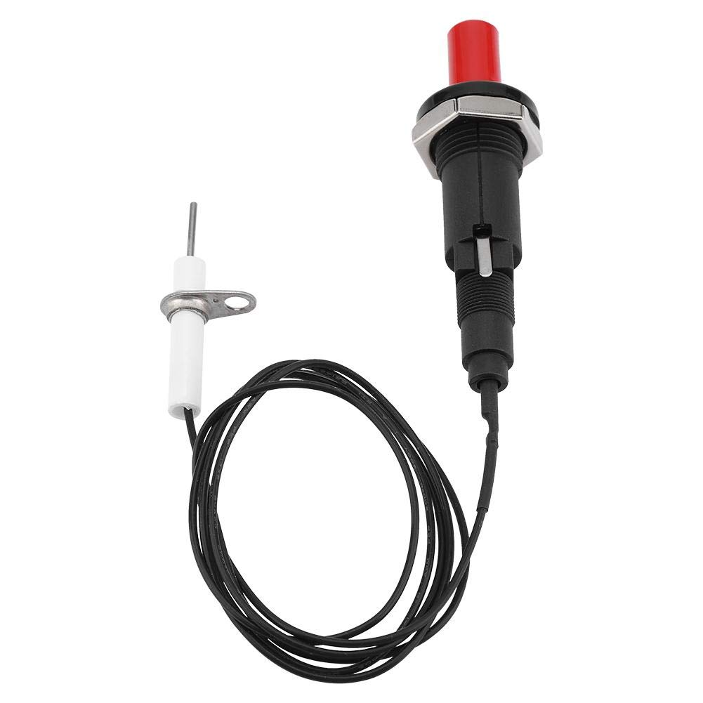
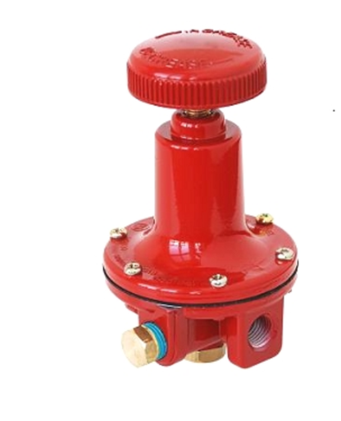
Ignition and Fuel
Ignition:
Piezo ignitor (seen in propane bbq) for simplicity
Fuel:
Propane ( readily available and cheap)
Provides the highest pressure regulators (about 100 psi )
Use copper tubing with hypodermic needles for fuel injection
Air- Fuel ratio will be determined experimental, because compressible flow is hard

Slide 12
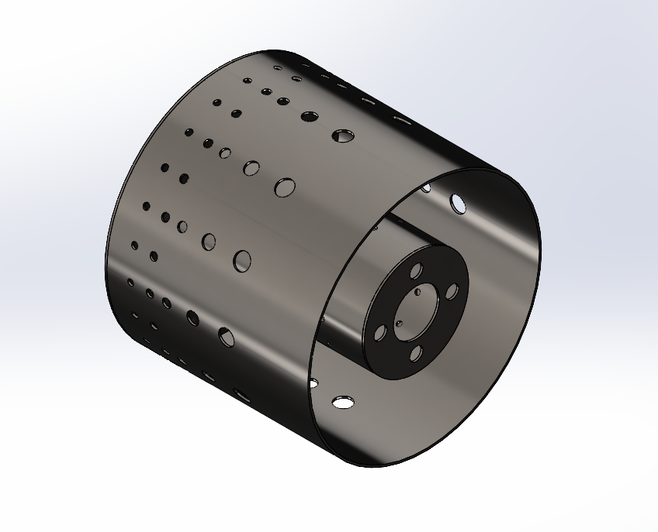
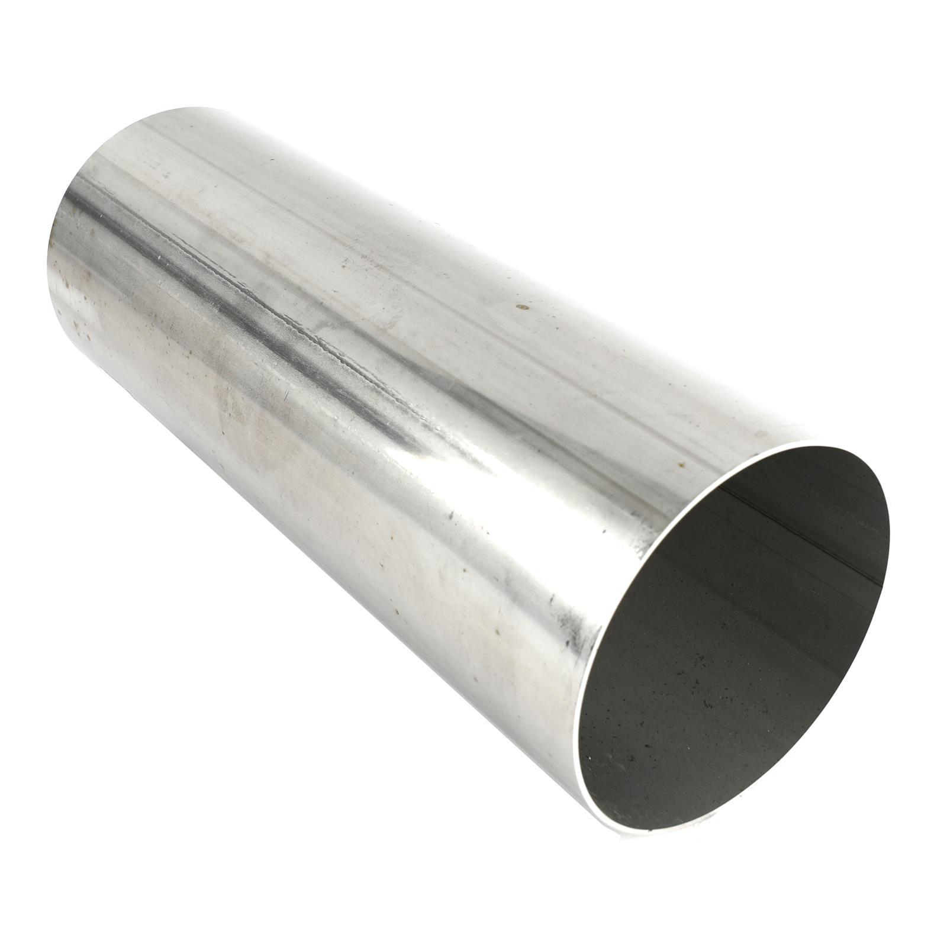
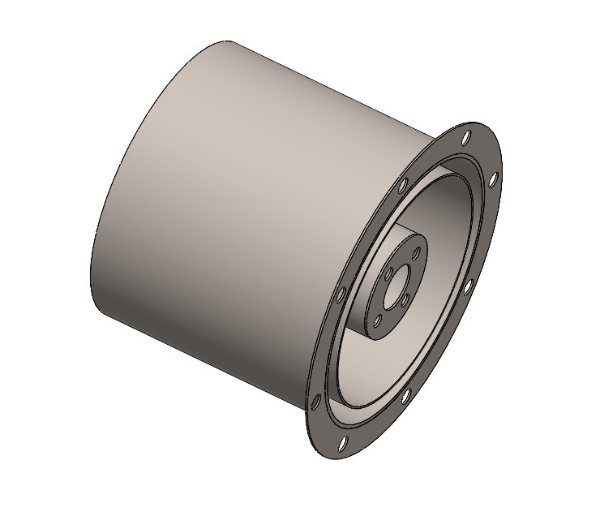
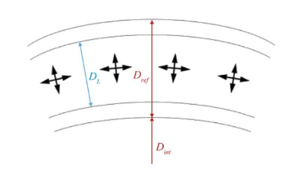
Combustion Chamber
Flame Tube:
Dimensions found in relation to casing and shaft housing diameter
Air admission hole pattern from Kamps for now, after data collection we can develop the most optimal pattern for our engine
304 SS 20ga, slip rolled and welded
Casing
4.5” OD stainless steel exhaust tubing cut to length
¼ 20 bolts to attach casing to outlet, 8 bolt pattern on flange

Slide 13
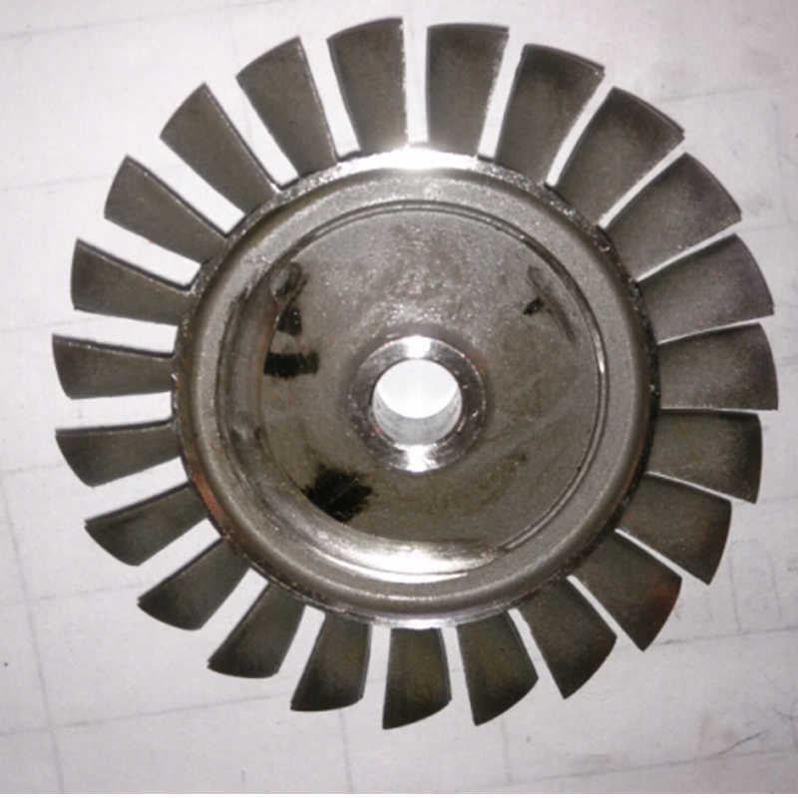
Turbine
Inconel better against thermal expansion
Axial flow
66mm(2.6in)
Already dynamically balanced
Built for micro jet engines
Matched with impeller
Design and manufacturing was too complex for manual machining and preliminary design

Slide 14
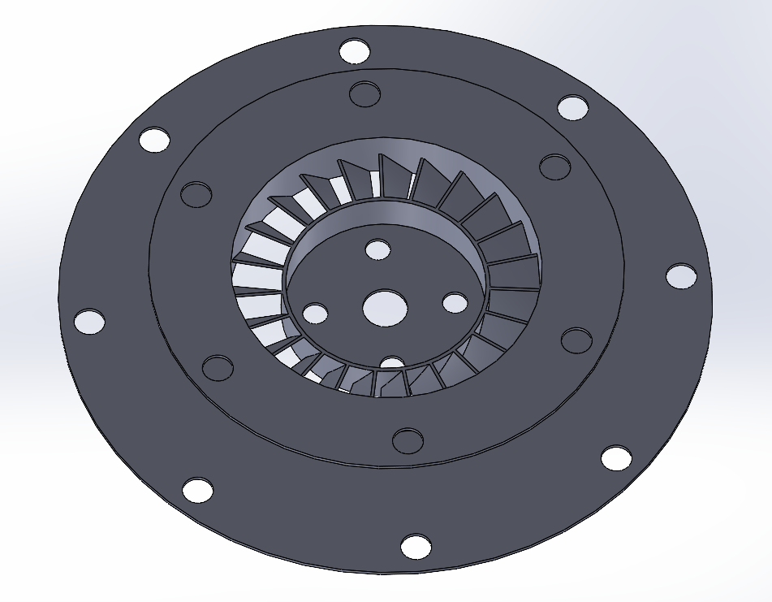
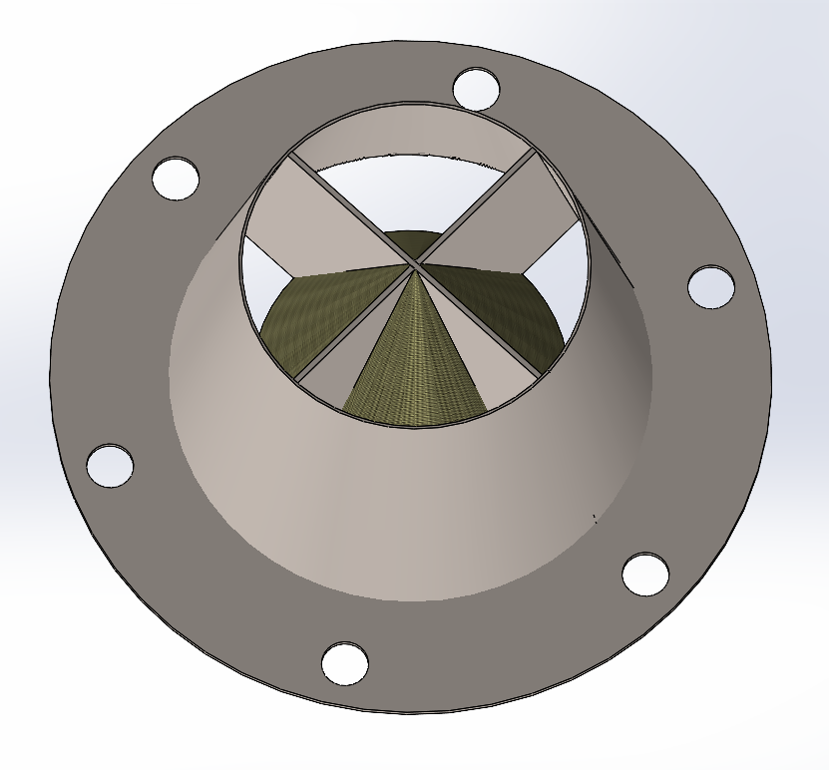
Stator & Nozzle
Nozzle:
Cone is meant to prevent area of low pressure causing back flow, carbon fiber mortar composite
Nozzle is meant to maintain a consistent flow area from the stator to outlet, 304 SS 20ga
Stator:
34° blade angle, chosen as optimal angle
Number of blades matched to turbine wheel
304 SS 20ga, waterjet, slip rolled, welded

Slide 15
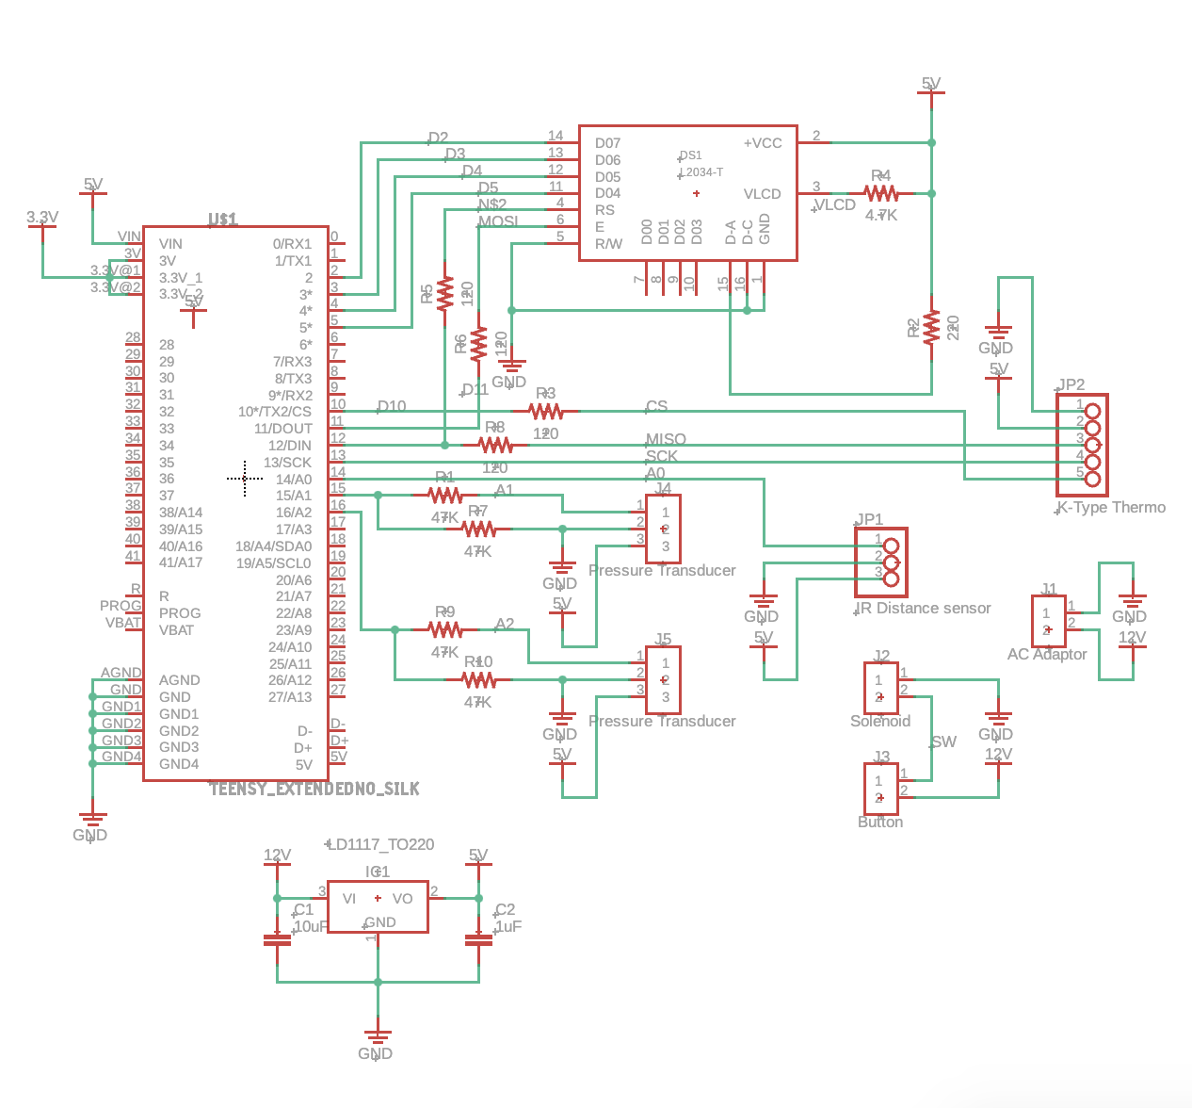
Instrumentation
Custom made PCB w/ Teensy
Temperature probe right before the stator
Pressure transducer right before the stator
Pressure transducer after diffuser to measure compression ratio
Laser tachometer

Slide 16
General Safety
Essentially a propane grill attachment
Dr. DeTurris supervision
Prop lab control room
Anything goes wrong – shut off fuel supply

Slide 17
Thank you for your time!

